Slide 1

UEEN 3113 / 3413
Server Configuration and management

Slide 2
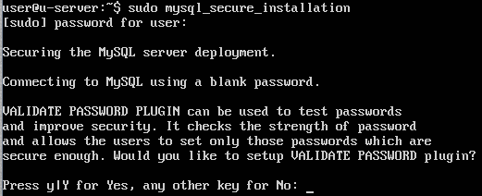
MySQL
To setup mysql after the installation:
mysql_secure_installation
First, we need to set the password for mysql root user.

Slide 3
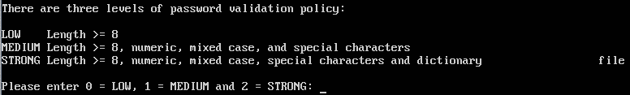
MySQL
Set the password validation policy
In case we need to remove the validation policy in a later time, login to mysql and run the command:
uninstall plugin validate_password;
Notes:
Medium level example: mySQL605

Slide 4
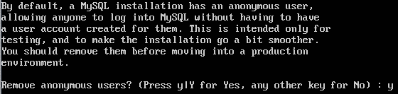
MySQL
Remove anonymous users

Slide 5
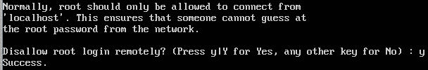
MySQL
Disable remote root login

Slide 6
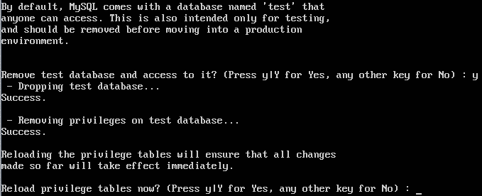
MySQL
Remove “test” database

Slide 7

MySQL
Reload privilege tables

Slide 8
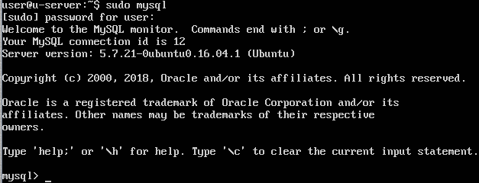
MySQL
Start the mysql command prompt: sudo mysql

Slide 9
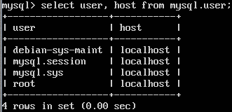
MySQL
To view user: select user, host from mysql.user;

Slide 10
MySQL
Reserved users
debian-sys-maint
Used by the init scripts to stop the server.
mysql.sys
Used as the DEFINER for sys schema objects, avoids problems that occur if root account is removed / renamed.
It’s locked and cannot be used for client connections.
mysql.session
Used internally by plugins to access to the server.
It’s locked and can’t be used for client connections.

Slide 11
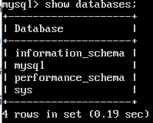
MySQL
Show all databases: show databases

Slide 12

MySQL
Output might not fix into screen (depend on the resolution), in order to view all the lines, we can pipe the output to less.
pager less
This is only effective in current logged in session.
To list in vertical mode, use \G, example:
select * from mysql.user \G

Slide 13
MySQL
Passwords can be written as plain text in SQL statements that invoke the PASSWORD() function.
If it is logged by the MySQL server, it is visible to anyone that can access to the log file.
However, logging will avoid writing passwords in clear text for a the following statements
CREATE USER, ALTER USER, GRANT, SET PASSWORD, SLAVE START, CREATE SERVER, ALTER SERVER

Slide 14
MySQL
To create a database:
CREATE DATABASE database_name;
Example: CREATE DATABASE stdb;
To make a database as current database:
USE database_name;
Example: USE stdb;
To know the current database in use:
SELECT database();

Slide 15
MySQL
To create a table:
CREATE TABLE table_name (field_name field_type(length));
Example:
CREATE TABLE st_item (item_id varchar(15), name varchar(25), location varchar(20));
Add primary key after a table is create:
ALTER TABLE table_name ADD PRIMARY KEY(filed_name);
Example:
ALTER TABLE st_item ADD PRIMARY KEY(item_id);

Slide 16
MySQL
Examples to create a table with primary key:
CREATE TABLE st_item (item_id varchar(15), name varchar(25), location varchar(20), primary key(item_id));
CREATE TABLE st_order (order_id int auto_increment, name varchar(30), primary key(order_id));

Slide 17
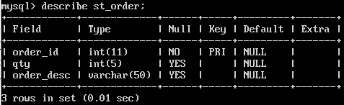
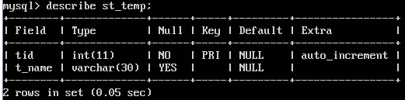
MySQL
To display the structure of a table:
DESCRIBE table_name;

Slide 18
MySQL
To remove a table:
DROP TABLE table_name;
To rename a table:
ALTER TABLE table_name RENAME new_table_name;
ALTER TABLE can be used to modify fields in a table:
ALTER TABLE st_item MODIFY st_item varchar(10), CHANGE name item_name varchar(20);

Slide 19
MySQL
To remove a field/column:
ALTER TABLE table_name DROP field_name;
To add a field/column:
ALTER TABLE table_name ADD new_field_name type;
Examples:
ALTER TABLE st_item ADD pic varchar(20);
ALTER TABLE st_item ADD item_brand varchar(20) AFTER item_name;
ALTER TABLE st_item ADD sup_id int AFTER item_name, ADD foreign key(sup_id) references item_sup(id);

Slide 20
MySQL
To create user:
CREATE USER ‘username’@’host’ IDENTIFIED BY ‘password’;
Examples:
CREATE USER ‘stadmin’@’localhost’ IDENTIFIED BY ‘stmin605’;
CREATE USER ‘stadmin’@’%’ IDENTIFIED BY ‘stmin605’;
Then, grant privileges to user:
GRANT privileges_list ON database.table TO ‘user’@’host’;
Example:
GRANT all privileges ON stdb.* TO ‘stdmin’@’localhost’;
Notes:
% is wildcard, means stadmin can connect from any host.

Slide 21
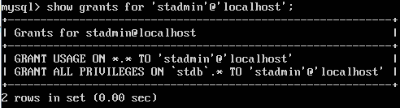
MySQL
To show the privileges granted to user:
SHOW GRANTS FOR ‘user_name’@’host’;
Example
SHOW GRANTS FOR ‘stadmin’@’localhost’;

Slide 22
MySQL
To remove privileges granted:
REVOKE privilges_list ON database.table FROM ‘user_name’@’host’;
Example:
REVOKE all privileges ON *.* FROM ‘stadmin’@’localhost’;
The following will remove all privileges (all global, database, table, column, and routine privileges)
REVOKE all privileges, grant option FROM ‘user_name’@’host’;

Slide 23
MySQL
Privilege | Column (in mysql.user) | Context
ALL PRIVILEGES | Synonym for “all privileges” | Server administration
ALTER | Alter_priv | Tables
CREATE | Create_priv | Databases, tables, or indexes
CREATE TABLESPACE | Create_tablespace_priv | Server administration
CREATE USER | Create_user_priv | Server administration
CREATE VIEW | Create_view_priv | Views
DELETE | Delete_priv | Tables
DROP | Drop_priv | Databases, tables, or views

Slide 24
MySQL
Privilege | Column (in mysql.user) | Context
GRANT OPTION | Grant_priv | Databases, tables, or stored routines
INDEX | Index_priv | Tables
INSERT | Insert_priv | Tables or columns
SELECT | Select_priv | Tables or columns
SHOW DATABASES | Show_db_priv | Server administration
SHOW VIEW | Show_view_priv | Views
UPDATE | Update_priv | Tables or columns
USAGE | Synonym for “no privileges” | Server administration

Slide 25
MySQL
For the full list of privileges, visit
https://dev.mysql.com/doc/refman/5.7/en/privileges-provided.html

Slide 26
MySQL
mysqldump can be used to backup databases
By default, mysqldump writes output to standard output, we need to redirect the output to a file in order to backup the databases into file.
mysqldump option > filename
Examples
mysqldump --all-databases > backup.sql
mysqldump --databases stdb salesdb > dump.sql
mysqldump –u root –p --all-databases > dumpall.sql

Slide 27
MySQL
To reload from dump file:
From shell: mysql < dump_file
From within mysql: source dump_file

Slide 28
MySQL - Cron
We can schedule the database backup using Cron.
Each user has their own set of Cron jobs.
To list the tasks scheduled by current user:
crontab -l
To list the tasks scheduled by other user:
crontab –u user_name -l

Slide 29
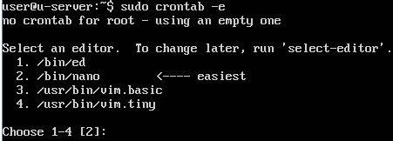
MySQL - Cron
To create Cron job:
crontab –e (for current user)
sudo crontab –e (for root user)
We are required to choose an editor if there are more than one editor.

Slide 30
MySQL - Cron
Each Cron job is specified in one line, which consists of 6 fields, separated by at least one space or tab.
m h dom mon dow command
m – minute
h – hour in 24-hour format (0 – 23)
dom – day of month (1 – 31)
mon – month (1 – 12)
dow – day of the week (0 – 6, represent Monday – Sunday)
We might want to use full path in command to make sure that it will run.

Slide 31
MySQL - Cron
Examples:
0 0 * * * /usr/bin/apt-get update
Run the apt update everyday at 12am. (* is a wildcard)
0 1 1 * * /usr/local/bin/monthly_cleanup.sh
Run a script on the first day of every month at 1am.

Slide 32
MySQL - Cron
However, mysqldump requires user name and password and definitely is unsafe to include password in the Cron job’s command.
Solution: place the password in user configuration file for mysql.
Copy /etc/alternatives/my.cnf to home directory as store as .my.cnf

Slide 33

MySQL - Cron
Open .my.cnf and add a [client] section.
We place the password under this section. Example:
Make sure that this file can only read by our own.
chmod 600 .my.cnf

Slide 34

MySQL - Cron
Now we can create a Cron job for mysqldump. Example

Slide 35
MySQL
Table maintenance statements
CHECK TABLE checks a table or tables for error.
Example: CHECK TABLE mysql.user;
OPTIMIZE TABLE reorganises the physical storage of table data and associated index data, to reduce storage space and improve I/O efficiency.
REPAIR TABLE repairs a possibly corrupted table.
Visit https://dev.mysql.com/doc/refman/5.7/en/table-maintenance-sql.html for more details

Slide 36
MySQL
By default, remote access to MySQL server is disabled.
To enable remote access, open and edit the configuration file: /etc/mysql/mysql.conf.d/mysqld.cnf
Look for the line: bind-address 127.0.0.1
This means MySQL can only be accessed from localhost
To enable remote access, change the adress to 0.0.0.0
To have MySQL support in PHP, install the php7.0-mysql package.

Slide 37
Apache
Apache support virtual hosts to host multiple websites from a single server.
To check the status of apache server:
systemctl status apache2
Each virtual host consist of a configuration file, differentiate based on name or IP address.
The default configuration file located at /etc/apache2/sites-available, named 000-default.conf
Can be duplicated and modified for different virtual hosts.

Slide 38
Apache
Content of configuration file
<VirtualHost *:80>
ServerAdmin webmaster@localhost
DocumentRoot /var/www/html
ErrorLog ${APACHE_LOG_DIR}/error.log
CustomLog ${APACHE_LOG_DIR}/access.log combined
</VirtualHost>

Slide 39
Apache
The access log contains information relating to incoming HTTP requests, by default it is stored in /var/log/access.log
Default Document Root located at /var/www/html
Create a separate directory for each virtual host in the document root
Change the permission of the directory accordingly

Slide 40
Apache
Steps in creating a virtual host
Create a directory for virtual host in /var/www
Change the ownership of the directory
Create a configuration file for the virtual host in /etc/apache2/sites-available
Enable the site with: a2ensite configuration_file
Reload apache
To disable a site: a2dissite configuration_file

Slide 41
Apache
Example, create a virtual host for scm.org
Create a directory for the virtual host
sudo mkdir -p /var/www/scm
Change the ownership of the directory
sudo chown –R $USER:$USER /var/www/scm
Copy the configuration file for virtual host
cd /etc/apache2/sites-available
sudo cp 000-default.conf scm.conf
Copy the default configuration as scm.conf (match with virtual host name for easier maintenance)

Slide 42
Apache
Example, create a virtual host for scm.org
Edit scm.conf with nano, change the following lines:
ServerName www.scm.org
ServerAdmin webmaster@scm.org
DocumentRoot /var/www/scm
ErrorLog ${APACHE_LOG_DIR}/scm_error.log
CustomLog ${APACHE_LOG_DIR}/scm_access.log combined

Slide 43
Apache
Example, create a virtual host for scm.org
Create an index.html in /var/www/scm
Enable the site
sudo a2ensite scm.conf
Reload apache service
sudo systemctl reload apache2

Slide 44
Apache
We can enable additional modules in apache. To view available modules:
a2enmod
To enable a module: a2enmod mod_name
To disable a module: a2dismod mod_name
Restart apache after enable / disable a module

Slide 45
Apache with SSL
By default, Apache is listening to port 80, not port 443 for HTTPS.
Check with: sudo netstat –tulpn | grep apache

Slide 46
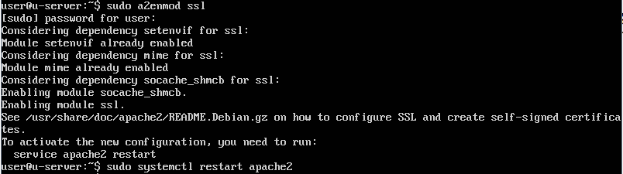
Apache with SSL
To enable HTTPS, we need to enable SSL module and restart Apache.
sudo a2enmod ssl
sudo systemctl restart apache2

Slide 47
Apache with SSL
A default site configuration for ssl is located at /etc/apache2/sites-available, named default-ssl.conf
_default_: apply to unspecified traffic on port 443, which hasn't been identified in any other virtual host
SSLEngine on: enables SSL traffic
<Directory> clause allows us to apply specific options to a directory.
The /usr/lib/cgi-bin directory is being applied to the SSLOptions +StdEnvVars setting, which enables default environment variables for use with SSL

Slide 48
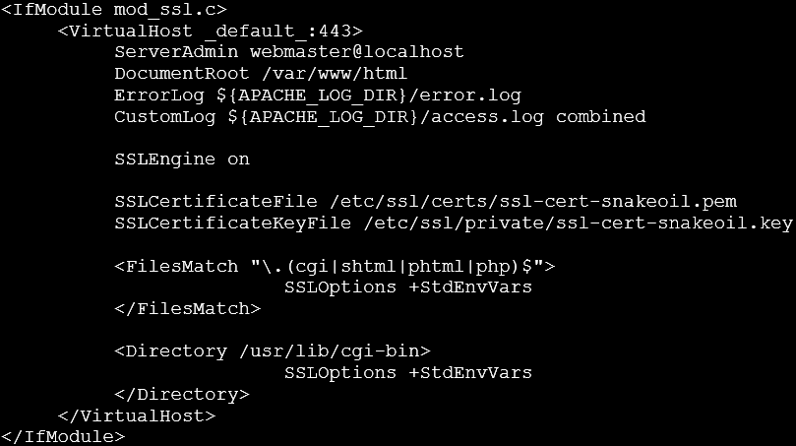
Apache with SSL

Slide 49
Apache with SSL
A default site configuration for ssl is located at /etc/apache2/sites-available, named default-ssl.conf
<FilesMatch>: allow us to apply specific options to files.
Files with extension of .cgi, .shtml, .phtml, or .php are being applied to the SSLOptions +StdEnvVars setting.
We can use the default-ssl.conf as template for each virtual host and include the server name in the file:
ServerName mydomain.com:443

Slide 50
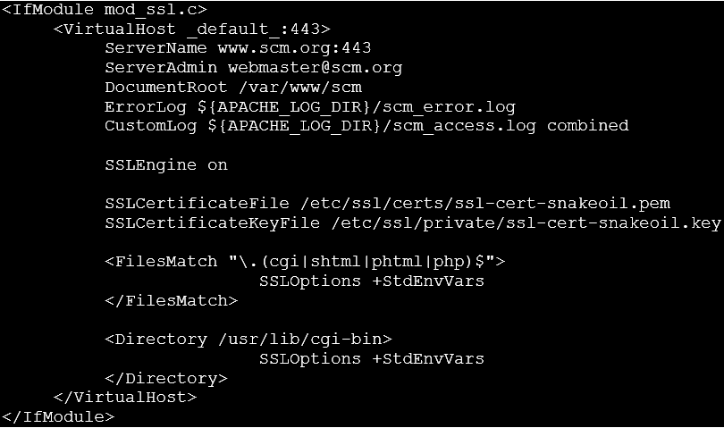
Apache with SSL

Slide 51
Apache with SSL
Once configured, we need to enable it:
sudo a2ensite ssl_conf_file
Example: sudo a2ensite scm-ssl.conf
Next, we need to install SSL certificates
Self-signed certificates (won’t be trusted by most browsers)
Vendor-signed certificates

Slide 52
Apache with SSL
Create a directory to store the certificates. Example,
sudo mkdir /etc/apache2/ssl-certs
Generate self-signed certificate and key:
openssl req -x509 -nodes -days 365 -newkey rsa:2048 -keyout /etc/apache2/certs/mysite.key -out /etc/apache2/certs/mysite.crt
We need to provide some information during the generating process.

Slide 53
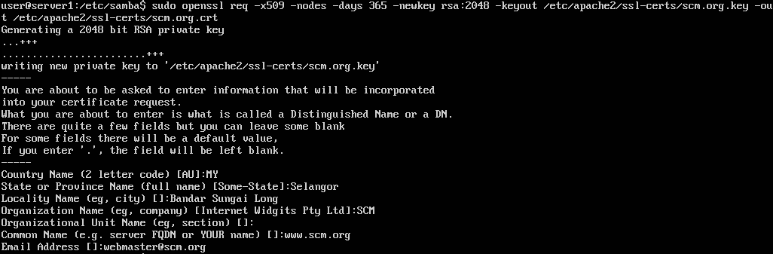
Apache with SSL
We need to provide some information during the generating process.

Slide 54

Apache with SSL
Configure Apache to use them. Comments out the following lines in configuration file:
Duplicate the two lines and change the paths to our certificate and key accordingly

Slide 55
Apache with SSL
Reload the apache
sudo systemctl reload apache2

Slide 56
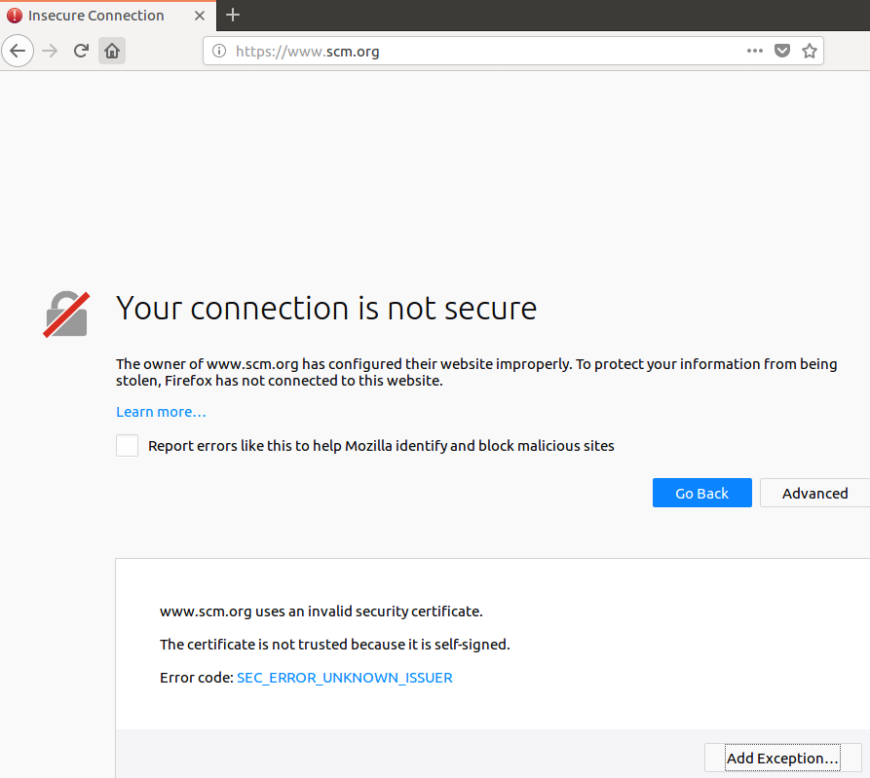
Apache with SSL

Slide 57
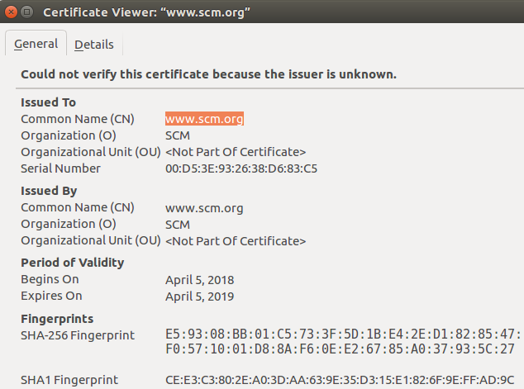
Apache with SSL

Slide 58
Apache with keepalived
keepalived allows us to configure a floating IP (Virtual IP or VIP) for a pool of servers, with the VIP being applied to a single server at a time.
Each server in the same group able to detect when another server isn't available, and claim ownership of the floating IP
Allows us to run a service on multiple servers, with a server taking over in the event another becomes unavailable.
Each server would need to contain the same Apache configuration and site files.

Slide 59
Apache with keepalived
By default, keepalived is not install, we need to install it:
sudo apt install keepalived
sudo apt-get install keepalived
There is no default configuration available, we need to create one, and store in /etc/keepalived
sudo nano /etc/keepalived/keepalived.conf

Slide 60
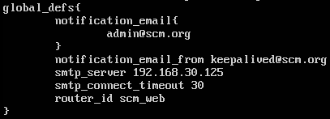
Apache with keepalived
In global_defs section, we specify the email address that will receive alert email from keepalived if issues occur.
keepliaved still can work without this section.

Slide 61
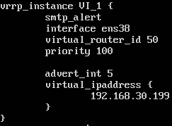
Apache with keepalived
Interface is the network interface where we would like keepalived to be bound to.
virtual_router_id is a special number from 0-255, used to differentiate multiple instances of keepalived running on the same subnet.

Slide 62
Apache with keepalived
Each member of a keepalived cluster should have the same virtual_router_id.
If there are multiple groups of servers on the same subnet, each group should have their own virtual_router_id.
The priority must be different on each server. Example,
Main server, priority = 100
Second server, priority = 90
Third server, priority = 80, and so on

Slide 63
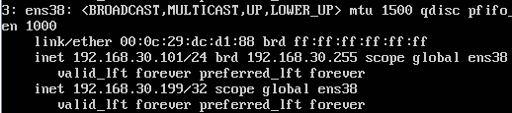
Apache with keepalived
Virtual IP must not be used by any other machine or in the IP range of dhcp server.
Once configured, we can start keepalived
sudo systemctl start keepalived
The virtual IP should be listed within the interface.

Slide 64
Apache with keepalived
The same configure file can be used in other servers in the same group with little modification, for example the priority number.
The line advert_int 5 in configuration means other server should take over within 5 seconds if the main server fails.

Slide 65
FTP server
Installation of vsftp (very secure FTP):
sudo apt install vsftp
The configuration file is /etc/vsftpd.conf
Remember to duplicate the file before modification
Once configure, restart the vsftp service
sudo systemctl restart vsftpd

Slide 66
FTP server
Installation of vsftp (very secure FTP):
sudo apt install vsftpd
The configuration file is /etc/vsftpd.conf
Remember to duplicate the file before modification
Once configure, restart the vsftp service
sudo systemctl restart vsftpd

Slide 67
FTP server
By default, anonymous FTP is disable:
anonymous_enable=NO
In order to enable FTP write command, i.e. transfer files to server, we need to uncomment the following line in the configuration file:
write_enable=YES
To restrict user to their home directory or certain directory:
chroot_local_user=YES

Slide 68
FTP server
To specify the directory for which the user is restricted to, add the following lines to configuration file:
local_root=/var/www/$USER
user_sub_token=$USER
The directory specified in local_root must NOT be writable by user. We need to remove the writable permission. Example
sudo chmod a-w /var/www/$USER

Slide 69
FTP server
Once configure, we can restart the vsftp service and try connect from other machine.

Slide 70


